Slide 1
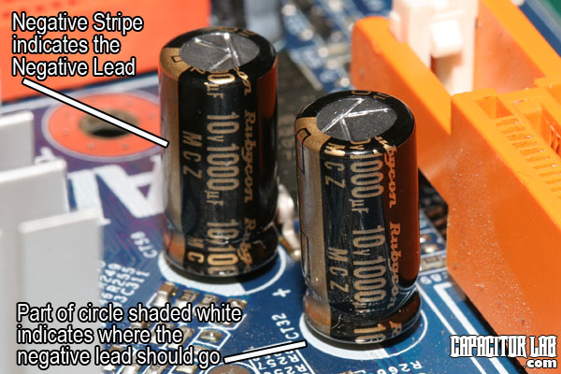
Capacitors

Slide 2
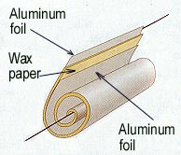
Capacitors
A capacitor is a device for storing electric charge.
It can be any device which can store charges.
Basically, capacitors consists of two metal plates separated by an insulator. The insulator is called dielectric. (e.g. polystyrene, oil or air)
Circuit symbol:
+
Dielectric
_

Slide 3
Charging of capacitors
When a capacitor is connected across a battery, electrons flow from the negative terminal of the battery to a plate of the capacitor connected to it. At the same rate, electrons flow from the other plate of the capacitor to the positive terminal of the battery. This gives a flow of current as the capacitor is being charged.
As charges accumulate on the plates of the capacitor, electric potential built across the plates. This hinders further accumulation of charges and makes the charge up current decreasing. When the potential difference across the plates equals that of the battery, the current becomes zero.

Slide 4
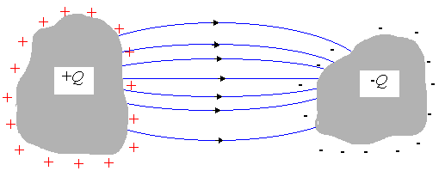
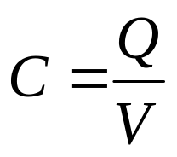
Capacitance (1)
Consider any isolated pair of conductors with charge Q
Capacitance is defined as
Unit : farad (F)
where Q = charge on one conductor
V = potential difference between two conductors

Slide 5

Capacitance of a Capacitor
Note that Q is not the net charge on the capacitor, which is zero.
Capacitance is a measure of a capacitor's ability to store charge.
The more charge a capacitor can hold at a given potential difference, the larger is the capacitance.
Capacitance is also a measure of the energy storage capability of a capacitor.
Unit of capacitance: CV⁻¹ or farad (F).
Farad is a very large unit. Common units are 1μF = 10⁻⁶ F, 1nF = 10⁻⁹ F and 1pF = 10⁻¹² F

Slide 6
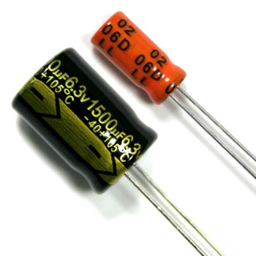
Markings of capacitor
Consider a ‘6.3V 1500μF’ capacitor shown in the following figure. Note that:
(1) Maximum voltage across the capacitor should not exceed 6.3 V, otherwise (leakage or) breakdown may occur.
(2) Capacitance of 1500μF means the capacitor holds 1500μC of charge for every 1 V of voltage across it.

Slide 7
Example 1
Find the maximum charge stored by the capacitor shown in the figure above.
Solution:

Slide 8
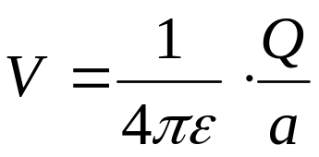
Capacitance of an isolated conducting sphere
Capacitance = Q/V
For an isolated conducting sphere,
Q
+
+
+
+
+
+
+
+
∴ C = Q/V = 4πεa
- - - - - - - -

Slide 9
Example 2
Find the capacitance of the earth given that the radius of the earth is 6 x 10⁶ m.
Solution

Slide 10
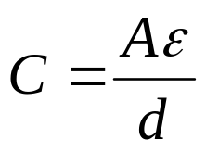
Permittivity of dielectric between the plates
Dielectric | Relative permittivity
Vacuum | 1
Air | 1.0006
Polythene | 2.3
Waxed paper | 2.7
Mica | 5.4
Glycerin | 43
Pure water | 80
Strontium titanate | 310
A dielectric is an insulator under the influence of an E field. The following table shows some dielectrics and their corresponding relative permittivity.
Capacitance can be increased by replacing the dielectric with one of higher permittivity.

Slide 11
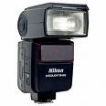
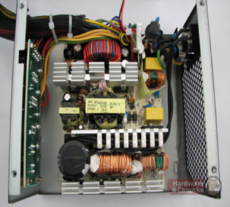
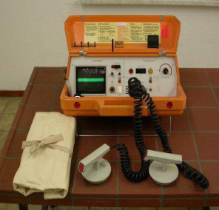
What are capacitors good for?
They store energy
  The energy stored is not extremely large, and it tends to leak away over time
  Gasoline or fuel cells are better for this purpose
They can release their energy very quickly
  Camera flashes, defibrillators, research uses
They resist changes in voltage
  Power supplies for electronic devices, etc.
They can be used for timing, frequency filtering, etc.
  In conjunction with other parts

